Slide 1
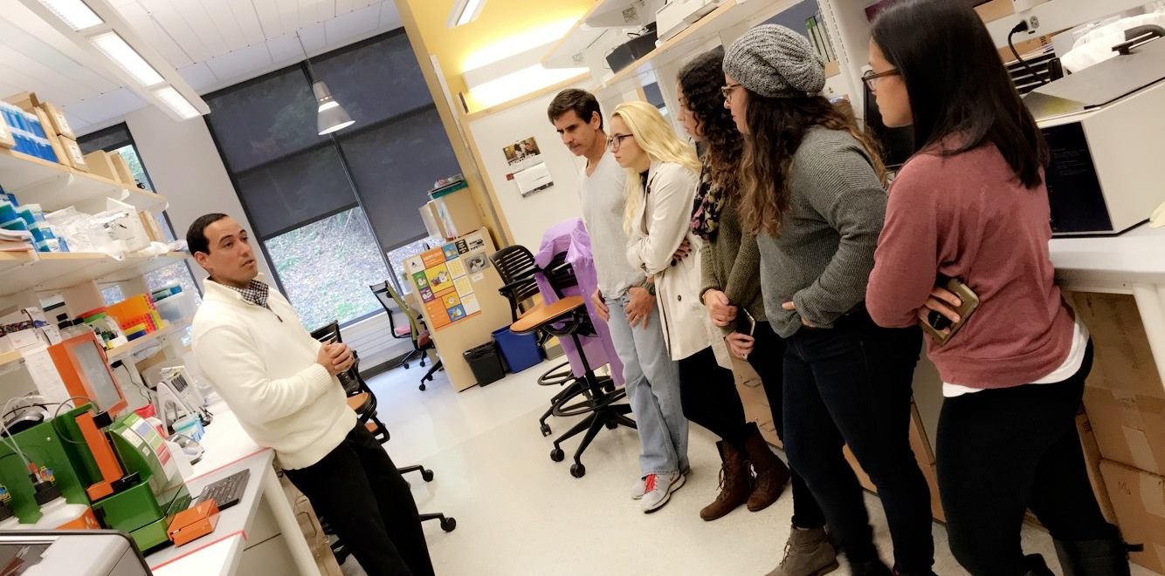
PIER
Pharmacy
Innovation
Experience
Research
Location:
Pharmacies in/around Pittsburgh
Program Dates:
February 7 - March 6, 2020
PIER is a four-week program that introduces undergraduate students in Pittsburgh to career options in the profession of Pharmacy
Apply Here!
www.bit.ly/PIERPITT20

